Slide 1
CS4038
DATA MINING
LECTURE # 12
SPRING 2024
FAST – NUCES, CFD CAMPUS
AYESHA LIAQAT
ayesha.liaqat@nu.edu.pk

Slide 2
TODAY’S TOPICS
Nearest neighbor classifier
Kd-tree

Slide 3

ILLUSTRATING CLASSIFICATION TASK
Tid | Attrib1 | Attrib2 | Attrib3 | Class
1 | Yes | Large | 125K | No
2 | No | Medium | 100K | No
3 | No | Small | 70K | No
4 | Yes | Medium | 120K | No
5 | No | Large | 95K | Yes
6 | No | Medium | 60K | No
7 | Yes | Large | 220K | No
8 | No | Small | 85K | Yes
9 | No | Medium | 75K | No
10 | No | Small | 90K | Yes
Learning algorithm
Induction
Learn Model
10
Training Set
Model
Apply Model
Tid | Attrib1 | Attrib2 | Attrib3 | Class
11 | No | Small | 55K | ?
12 | Yes | Medium | 80K | ?
13 | Yes | Large | 110K | ?
14 | No | Small | 95K | ?
15 | No | Large | 67K | ?
Deduction
10
Test Set

Slide 4
Set of Stored Cases
INSTANCE-BASED CLASSIFIERS
Atr1 | ……... | AtrN | Class
 |  |  | A
 |  |  | B
 |  |  | B
 |  |  | C
 |  |  | A
 |  |  | C
 |  |  | B
Store the training records
Use training records to predict the class label of unseen cases
Unseen Case
Atr1 | ……... | AtrN

Slide 5
INSTANCE-BASED CLASSIFIERS
Examples:
Rote-learner
Memorizes entire training data and performs classification only if attributes of record match one of the training examples exactly
Nearest neighbor classifier
Uses k “closest” points (nearest neighbors) for performing classification
Can be used for both classification and regression (supervised machine learning problems)
Notes:
Lazy learners:
1)No model building needed. Only distances are computed but it may be quite expensive O(n)
2)Decisions based on local information 3)require efficient storage techniques

Slide 6
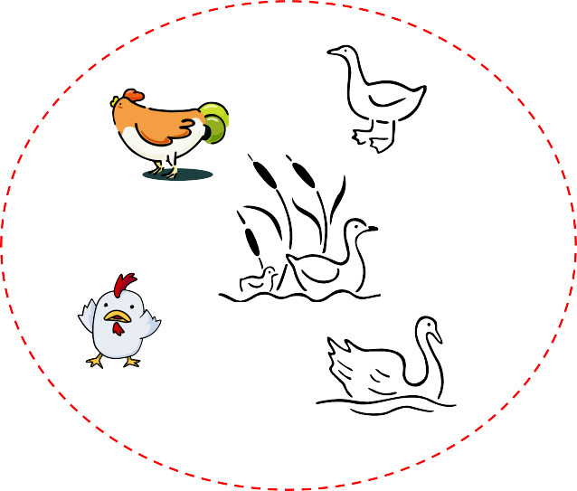
NEAREST NEIGHBOR CLASSIFIER
Basic idea:
“If it walks like a duck, quacks like a duck, then it’s probably a duck”
Compute Distance
Test Record
Training Records
Choose k of the “nearest” records

Slide 7
NEAREST NEIGHBOR CLASSIFIER
Unknown record
Requires three things
The set of stored records
Distance Metric to compute distance between records
The value of k, the number of nearest neighbors to retrieve
To classify an unknown record:
Compute distance to other training records
Identify k nearest neighbors
Use class labels of nearest neighbors to determine the class label of unknown record (e.g., by taking majority vote)

Slide 8





DEFINITION OF NEAREST NEIGHBOR
X
X
X
(a) 1-nearest neighbor (b) 2-nearest neighbor (c) 3-nearest neighbor
K-nearest neighbors of a record x are data points that have the k smallest distance to x

Slide 9
NEAREST NEIGHBOR CLASSIFICATION
Compute distance between two points:
Euclidean distance
d ( p, q) = ∑ ( p − q )²
i
i i
Determine the class from nearest neighbor list
Unweighted Voting: Take the majority vote of class labels among the k- nearest neighbors
Weighted Voting: Weight the vote according to distance
weight factor, w = 1/d²

Slide 10
NEAREST NEIGHBOR CLASSIFICATION…
Choosing the value of k:
If k is too small, sensitive to noise points
If k is too large, neighborhood may include points from other classes
X
Notes:
For instance, if �k is set to the total number of training examples, the majority class in the entire dataset may dominate the classification decision

Slide 11
NEAREST NEIGHBOR CLASSIFICATION…
Scaling issues
Attributes may have to be scaled to prevent distance measures from being dominated by one of the attributes
Example:
height of a person may vary from 1.5m to 1.8m
weight of a person may vary from 90lb to 300lb
income of a person may vary from $10K to $1M

Slide 12
NEAREST NEIGHBOR CLASSIFICATION…
Problem with Euclidean measure:
High dimensional data
curse of dimensionality
Can produce counter-intuitive results
1 1 1 1 1 1 1 1 1 1 1 0
1 0 0 0 0 0 0 0 0 0 0 0
vs
0 1 1 1 1 1 1 1 1 1 1 1
0 0 0 0 0 0 0 0 0 0 0 1
d = 1.4142 d = 1.4142
Solution: Normalize the vectors to unit length
Notes:
Not good for: high dimensional data, imbalanced data, large datasets

Slide 13
NEAREST NEIGHBOR CLASSIFICATION…
k-NN classifiers are lazy learners
It does not build models explicitly
Unlike eager learners such as decision trees
Classifying unknown records are relatively expensive
Naïve algorithm: O(n)
Need for structures to retrieve nearest neighbors fast.
The Nearest Neighbor Search problem.

Slide 14
FINDING NEAREST NEIGHBOR USING KD-TREE

Slide 15
NEAREST NEIGHBOR SEARCH
kd-tree (k-dimensional tree)
A data structure for answering nearest neighbor queries in R²
kd-tree construction algorithm
Select the x or y dimension (alternating between the two)
Partition the space into two with a line passing from the median point
Repeat recursively in the two partitions as long as there are enough points

Slide 16
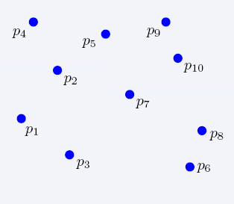
NEAREST NEIGHBOR SEARCH
2-dimensional kd-trees

Slide 17
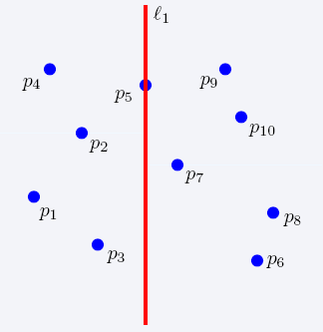
NEAREST NEIGHBOR SEARCH
2-dimensional kd-trees

Slide 18
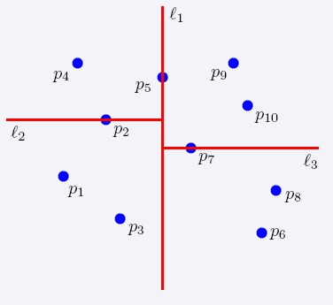
NEAREST NEIGHBOR SEARCH
2-dimensional kd-trees

Slide 19
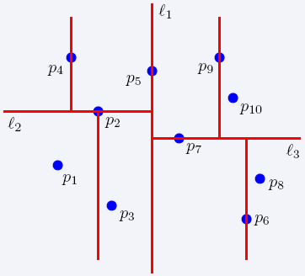
NEAREST NEIGHBOR SEARCH
2-dimensional kd-trees

Slide 20
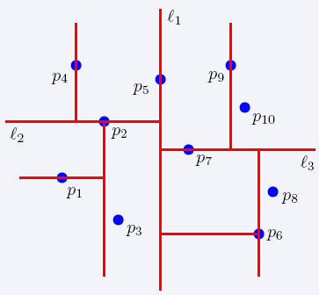
NEAREST NEIGHBOR SEARCH
2-dimensional kd-trees

Slide 21
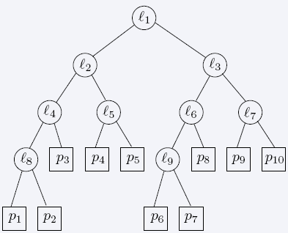
NEAREST NEIGHBOR SEARCH
2-dimensional kd-trees

Slide 22
READING MATERIAL
Chapter 5:Tan, Steinbach & Kumar
Chapter 9: Han, Kamber & Pei
Chapter 10: D. Larose & C. Larose
Articles on KNN:
https://towardsdatascience.com/k-nearest-neighbor-85bd50ea3e4d
https://www.analyticsvidhya.com/blog/2018/03/introduction-k-neighbours-algorithm- clustering/

